Slide 1
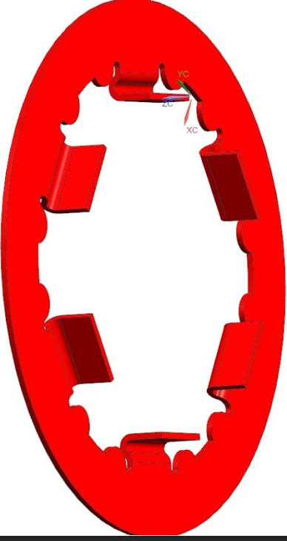
LRA: Stamped Stators (11MY16)
The current stators are PhFe powered metal
New design uses stamped SiFe
1st parts built and tested
14% gain reductions
Modeling options to improve gain
2nd stators complete
Will be built into LRA week of 09MY16
Delayed to ~27MY16
Quote received from Agape for LRA
$0.79 (current design $1.22 to $1.52)
Stator quotes
Current price: $0.27
New design: $0.11 (two stators per assembly)
1

